Slide 1
What have we learned on the course Algorithm Design?
dbu@ict.ac.cn
2024

Slide 2
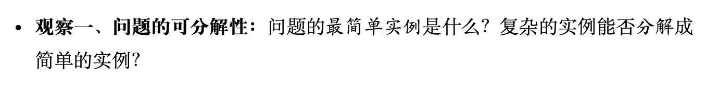
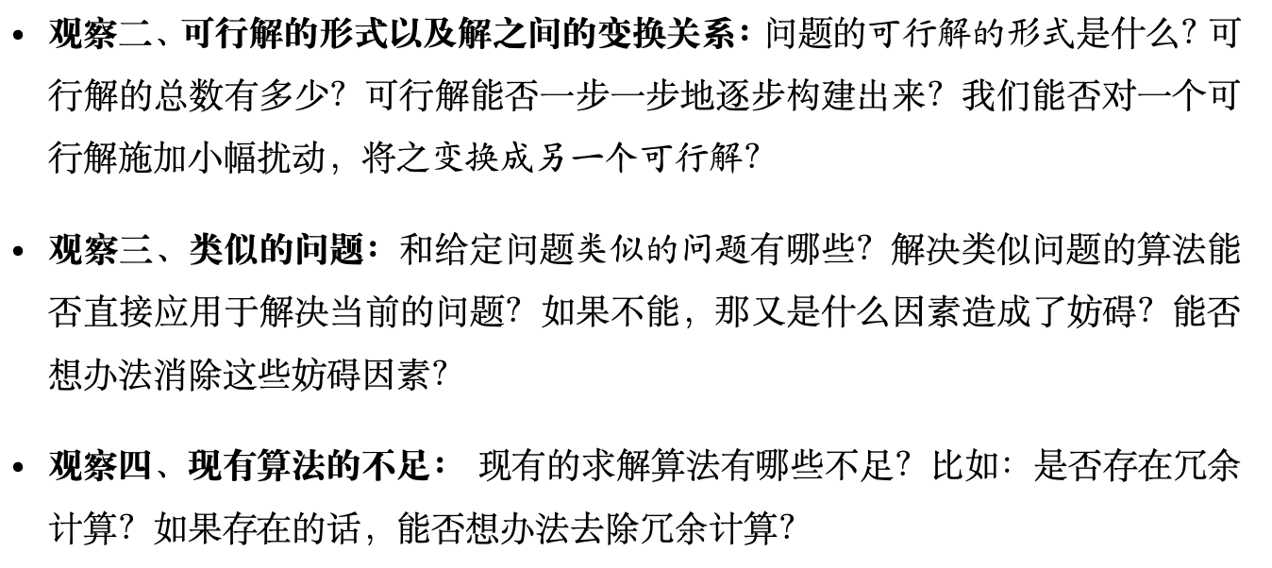
How to solve problems?

Slide 3
Several lessons
基于对问题结构观察的算法设计；
从最简单的例子做起；
试图把大的问题分解成小问题；
试图从粗糙解开始逐步改进；
试图枚举所有的解，但是“being smart”;
难以优化的函数，用下界或上界函数替代,e.g, EM, Lagrangian, log barrier
复杂操作的潜力一定要挖尽, e.g., Dinic’s algorithm
求同时满足多个条件的解，分步满足，并利用对称性, e.g., 3 strategies to solve LP, Push relabel;
想想对偶, e.g., primal and dual;
Random sampling, e.g., select a pivot;
Scaling + rounding, e.g., Scaling FF, closest-pair;
Best => sufficiently good, e.g., select a pivot, scaling FF, push relabel;

Slide 4
Acknowledgements

Slide 5
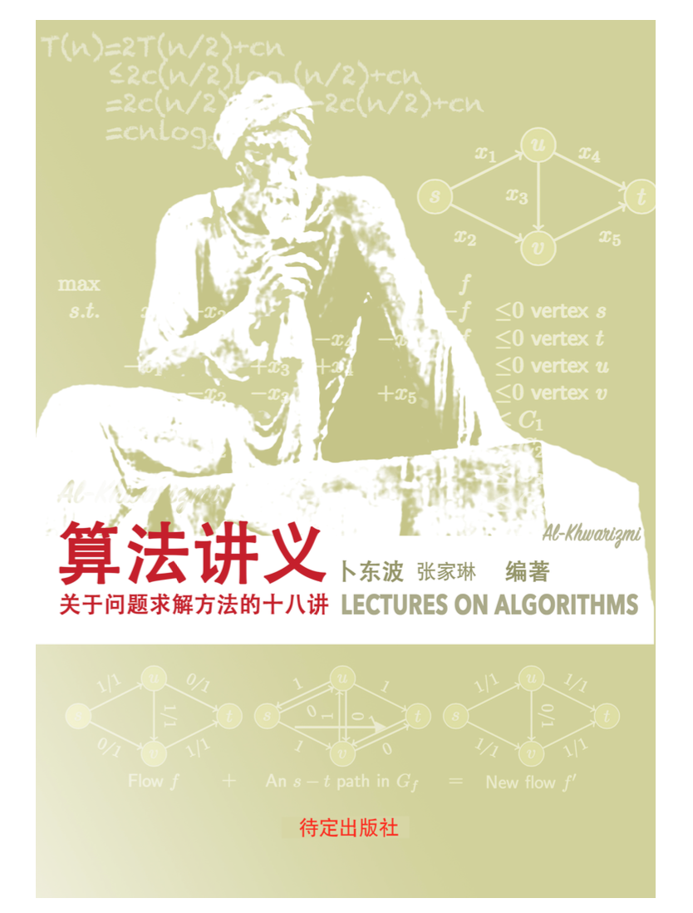
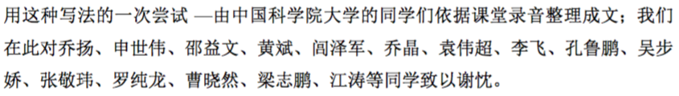
Thanks the scribes

Slide 6
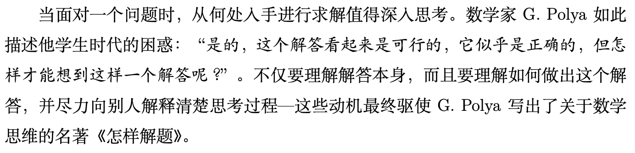
Polya的《怎样解题》

Slide 7

What is a good book？

Slide 8
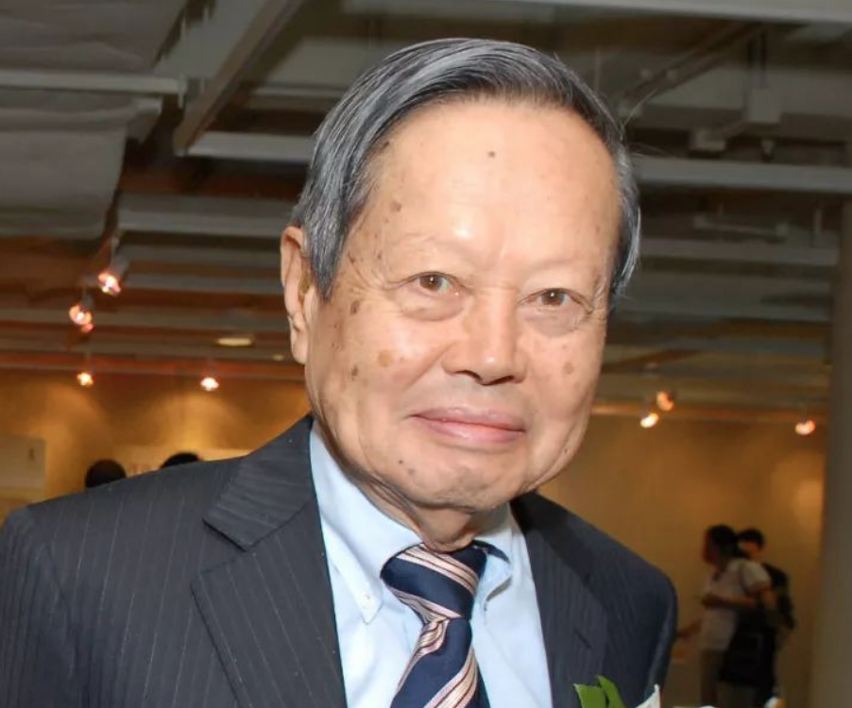
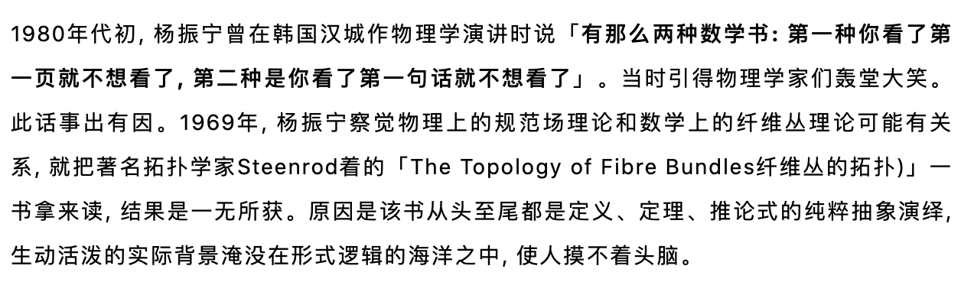
What is a bad book?

Slide 9

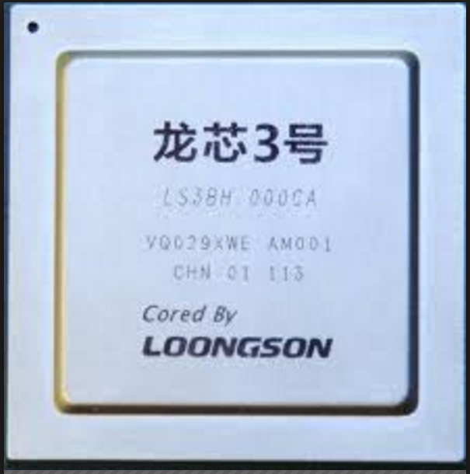
Thank Loongson
These software run smoothly on Loongson!
Text processing:
TexShop, Latex,…
Word, Powerpoint, evince, ...
Mathematical packages:
GLPK
Octave (MatLab)
Image processing:
GIMP, gnuplot, ….
Programming languages:
Python, perl, gcc, g++, ...
.....

Slide 10
Thank you all!

